Slide 1
Software Design and Analysis
Chapter 10
MD. NURUL AHAD TAWHID
ASSISTANT PROFESSOR
INSTITUTE OF INFORMATION TECHNOLOGY
UNIVERSITY OF DHAKA

Slide 2
Chapter 10 Component-Level Design
Introduction
The software component
Designing class-based components
Designing conventional components

Slide 3
Introduction

Slide 4
Background
Component-level design occurs after the first iteration of the architectural design
It strives to create a design model from the analysis and architectural models
  The translation can open the door to subtle errors that are difficult to find and correct later
  “Effective programmers should not waste their time debugging – they should not introduce bugs to start with.” Edsgar Dijkstra
A component-level design can be represented using some intermediate representation (e.g. graphical, tabular, or text-based) that can be translated into source code
The design of data structures, interfaces, and algorithms should conform to well-established guidelines to help us avoid the introduction of errors

Slide 5
The Software Component

Slide 6
Defined
A software component is a modular building block for computer software
  It is a modular, deployable, and replaceable part of a system that encapsulates implementation and exposes a set of interfaces
A component communicates and collaborates with
  Other components
  Entities outside the boundaries of the system
Three different views of a component
  An object-oriented view
  A conventional view
  A process-related view

Slide 7
Object-oriented View
A component is viewed as a set of one or more collaborating classes
Each problem domain (i.e., analysis) class and infrastructure (i.e., design) class is elaborated to identify all attributes and operations that apply to its implementation
  This also involves defining the interfaces that enable classes to communicate and collaborate
This elaboration activity is applied to every component defined as part of the architectural design
Once this is completed, the following steps are performed
  Provide further elaboration of each attribute, operation, and interface
  Specify the data structure appropriate for each attribute
  Design the algorithmic detail required to implement the processing logic associated with each operation
  Design the mechanisms required to implement the interface to include the messaging that occurs between objects

Slide 8
Conventional View
A component is viewed as a functional element (i.e., a module) of a program that incorporates
  The processing logic
  The internal data structures that are required to implement the processing logic
  An interface that enables the component to be invoked and data to be passed to it
A component serves one of the following roles
  A control component that coordinates the invocation of all other problem domain components
  A problem domain component that implements a complete or partial function that is required by the customer
  An infrastructure component that is responsible for functions that support the processing required in the problem domain
(More on next slide)

Slide 9
Conventional View (continued)
Conventional software components are derived from the data flow diagrams (DFDs) in the analysis model
  Each transform bubble (i.e., module) represented at the lowest levels of the DFD is mapped into a module hierarchy
  Control components reside near the top
  Problem domain components and infrastructure components migrate toward the bottom
  Functional independence is strived for between the transforms
Once this is completed, the following steps are performed for each transform
  Define the interface for the transform (the order, number and types of the parameters)
  Define the data structures used internally by the transform
  Design the algorithm used by the transform (using a stepwise refinement approach)

Slide 10
Process-related View
Emphasis is placed on building systems from existing components maintained in a library rather than creating each component from scratch
As the software architecture is formulated, components are selected from the library and used to populate the architecture
Because the components in the library have been created with reuse in mind, each contains the following:
  A complete description of their interface
  The functions they perform
  The communication and collaboration they require

Slide 11
Designing Class-Based Components

Slide 12
Component-level Design Principles
Open-closed principle
  A module or component should be open for extension but closed for modification
  The designer should specify the component in a way that allows it to be extended without the need to make internal code or design modifications to the existing parts of the component
Liskov substitution principle
  Subclasses should be substitutable for their base classes
  A component that uses a base class should continue to function properly if a subclass of the base class is passed to the component instead
Dependency inversion principle
  Depend on abstractions (i.e., interfaces); do not depend on concretions
  The more a component depends on other concrete components (rather than on the interfaces) the more difficult it will be to extend
Interface segregation principle
  Many client-specific interfaces are better than one general purpose interface
  For a server class, specialized interfaces should be created to serve major categories of clients
  Only those operations that are relevant to a particular category of clients should be specified in the interface

Slide 13
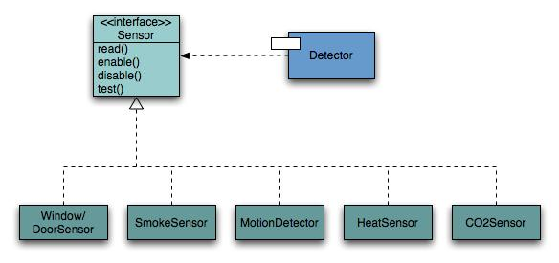
Open-Closed Principle
A module should be open for extension but closed for modification.

Slide 14
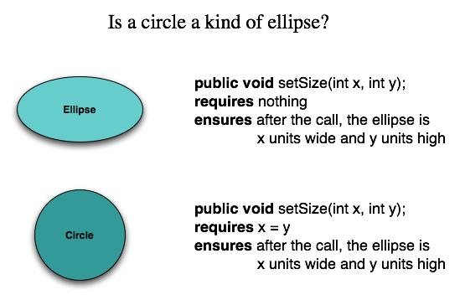
Substitutability
Subclasses should be substitutable for base classes

Slide 15
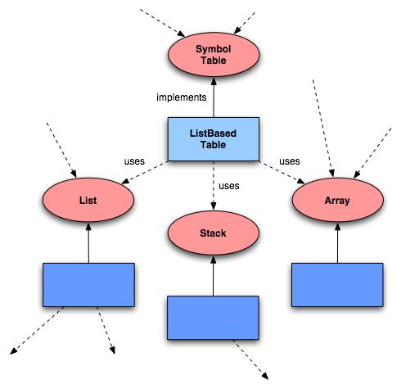
Dependency Inversion
Depend on abstractions. Do not depend on concretions.

Slide 16
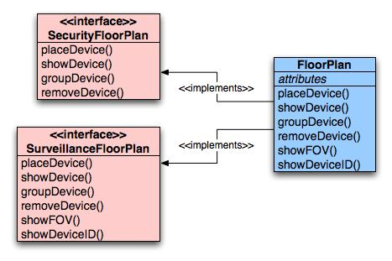
Interface Segregation
Many client-specific interfaces are better than one general purpose interface.

Slide 17
Component Packaging Principles
Release reuse equivalency principle
  The granularity of reuse is the granularity of release
  Group the reusable classes into packages that can be managed, upgraded, and controlled as newer versions are created
Common closure principle
  Classes that change together belong together
  Classes should be packaged cohesively; they should address the same functional or behavioral area on the assumption that if one class experiences a change then they all will experience a change
Common reuse principle
  Classes that aren't reused together should not be grouped together
  Classes that are grouped together may go through unnecessary integration and testing when they have experienced no changes but when other classes in the package have been upgraded

Slide 18
Component-Level Design Guidelines
Components
  Establish naming conventions for components that are specified as part of the architectural model and then refined and elaborated as part of the component-level model
  Obtain architectural component names from the problem domain and ensure that they have meaning to all stakeholders who view the architectural model (e.g., Calculator)
  Use infrastructure component names that reflect their implementation-specific meaning (e.g., Stack)
Dependencies and inheritance in UML
  Model any dependencies from left to right and inheritance from top (base class) to bottom (derived classes)
  Consider modeling any component dependencies as interfaces rather than representing them as a direct component-to-component dependency

Slide 19
Cohesion
Cohesion is the “single-mindedness’ of a component
It implies that a component or class encapsulates only attributes and operations that are closely related to one another and to the class or component itself
The objective is to keep cohesion as high as possible
The kinds of cohesion can be ranked in order from highest (best) to lowest (worst)
  Functional
    A module performs one and only one computation and then returns a result
  Layer
    A higher layer component accesses the services of a lower layer component, Exhibited by packages, components, classes
  Communicational
    All operations that access the same data are defined within one class
(More on next slide)

Slide 20
Cohesion (continued)
Kinds of cohesion (continued)
  Sequential
    Components or operations are grouped in a manner that allows the first to provide input to the next and so on in order to implement a sequence of operations
  Procedural
    Components or operations are grouped in a manner that allows one to be invoked immediately after the preceding one was invoked, even when no data passed between them
  Temporal
    Operations are grouped to perform a specific behavior or establish a certain state such as program start-up or when an error is detected
  Utility
    Components, classes, or operations are grouped within the same category because of similar general functions but are otherwise unrelated to each other

Slide 21
Functional Cohesion
Typically applies to operations. Occurs when a module performs one and only one computation and then returns a result.
Function A part 1
Function A part 2
Function A part 3
Functional
Sequential with complete, related functions

Slide 22
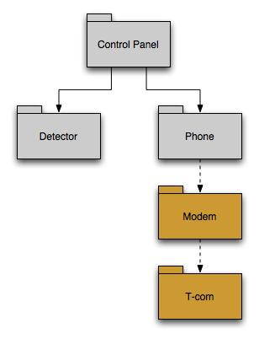
Layer Cohesion
Applies to packages, components, and classes. Occurs when a higher layer can access a lower layer, but lower layers do not access higher layers.

Slide 23
Communicational Cohesion
All operations that access the same data are defined within one class.
In general, such classes focus solely on the data in question, accessing and storing it.
Example:
Function A
Function B
Function C
Communicational Access same data

Slide 24
Examples of Cohesion
Function A
Function B
Function C
Time t₀
Time t₀ + X
Time t₀ + 2X
Sequential
Output of one is input to another
Temporal
Related by time
Function A
Function B
Function C
Function A
Function A’
Function A’’
logic
Procedural
Related by order of functions
Utility
Similar functions

Slide 25
Coupling
As the amount of communication and collaboration increases between operations and classes, the complexity of the computer-based system also increases
As complexity rises, the difficulty of implementing, testing, and maintaining software also increases
Coupling is a qualitative measure of the degree to which operations and classes are connected to one another
The objective is to keep coupling as low as possible
(More on next slide)

Slide 26
Coupling: Degree of dependence among components
No dependencies
Loosely coupled-some dependencies
High coupling makes modifying parts of the system difficult, e.g., modifying a component affects all the components to which the component is connected.
Highly coupled-many dependencies

Slide 27
Coupling (continued)
The kinds of coupling can be ranked in order from lowest (best) to highest (worst)
  Data coupling
    Operation A() passes one or more atomic data operands to operation B(); the less the number of operands, the lower the level of coupling
  Stamp coupling
    A whole data structure or class instantiation is passed as a parameter to an operation
  Control coupling
    Operation A() invokes operation B() and passes a control flag to B that directs logical flow within B()
    Consequently, a change in B() can require a change to be made to the meaning of the control flag passed by A(), otherwise an error may result
  Common coupling
    A number of components all make use of a global variable, which can lead to uncontrolled error propagation and unforeseen side effects
  Content coupling
    One component secretly modifies data that is stored internally in another component
(More on next slide)

Slide 28
Coupling (continued)
Other kinds of coupling (unranked)
  Subroutine call coupling
    When one operation is invoked it invokes another operation within side of it
  Type use coupling
    Component A uses a data type defined in component B, such as for an instance variable or a local variable declaration
    If/when the type definition changes, every component that declares a variable of that data type must also change
  Inclusion or import coupling
    Component A imports or includes the contents of component B
  External coupling
    A component communicates or collaborates with infrastructure components that are entities external to the software (e.g., operating system functions, database functions, networking functions)

Slide 29
Content Coupling
Occurs when one component “surreptitiously modifies data that is internal to another component”
Violates information hiding
What’s wrong here? →
public class StudentRecord {
private String name;
private int[ ] quizScores;
public String getName() {
return name;
}
public int getQuizScore(int n) {
return quizScores[n];
}
public int[ ] getAllQuizScores() {
return quizScores;
}
….

Slide 30
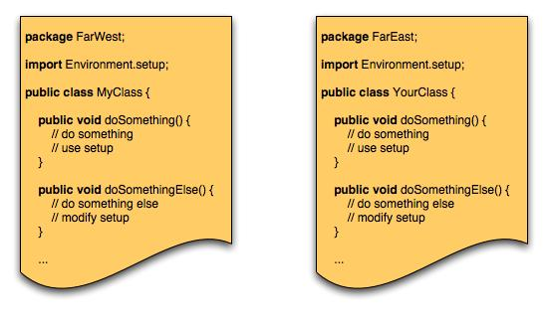
Common Coupling
Occurs when a number of components all make use of a global variable.

Slide 31
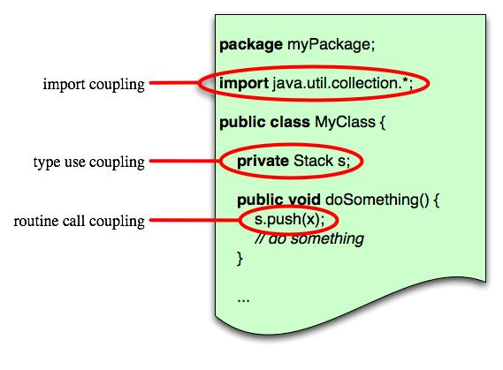
Routine Coupling
Certain types of coupling occur routinely in object-oriented programming.

Slide 32
Conducting Component-Level Design
Identify all design classes that correspond to the problem domain as defined in the analysis model and architectural model
Identify all design classes that correspond to the infrastructure domain
  These classes are usually not present in the analysis or architectural models
  These classes include GUI components, operating system components, data management components, networking components, etc.
Elaborate all design classes that are not acquired as reusable components
  Specify message details (i.e., structure) when classes or components collaborate
  Identify appropriate interfaces (e.g., abstract classes) for each component
  Elaborate attributes and define data types and data structures required to implement them (usually in the planned implementation language)
  Describe processing flow within each operation in detail by means of pseudo code or UML activity diagrams
(More on next slide)

Slide 33
Conducting Component-Level Design (continued)
Describe persistent data sources (databases and files) and identify the classes required to manage them
Develop and elaborate behavioral representations for a class or component
  This can be done by elaborating the UML state diagrams created for the analysis model and by examining all use cases that are relevant to the design class
Elaborate deployment diagrams to provide additional implementation detail
  Illustrate the location of key packages or classes of components in a system by using class instances and designating specific hardware and operating system environments
Factor every component-level design representation and always consider alternatives
  Experienced designers consider all (or most) of the alternative design solutions before settling on the final design model
  The final decision can be made by using established design principles and guidelines

Slide 34
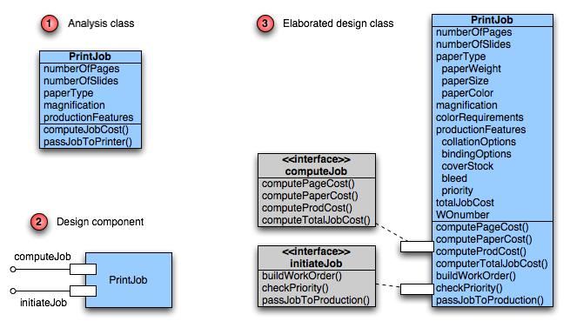
Class Elaboration

Slide 35
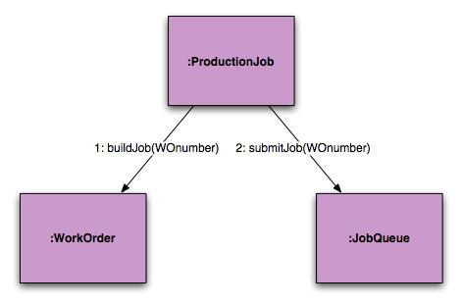
3a. Collaboration Details
Messages can be elaborated by expanding their syntax in the following manner:
  [guard condition] sequence expression (return value) :=
  message name (argument list)

Slide 36
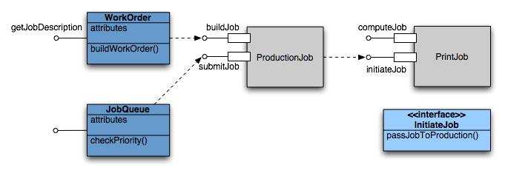
3b. Appropriate Interfaces
The PrintJob interface “initiateJob” in previous slide does not exhibit sufficient cohesion because it performs three different subfunctions. So refactoring this.

Slide 37
3c. Elaborate Attributes
Analysis classes will typically only list names of general attributes (ex. paperType).
List all attributes during component design.
UML syntax:
  name : type-expression = initial-value { property string }
For example, paperType can be broken into weight, size, and color. The weight attribute would be:
  paperType-weight: string =
  “A” { contains 1 of 4 values – A, B, C, or D }

Slide 38
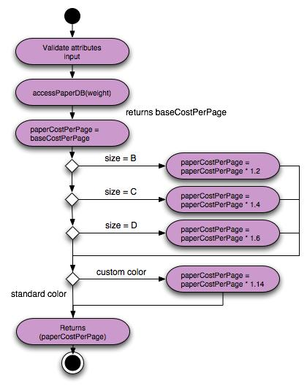
3d. Describe Processing Flow
computePaperCost (weight, size, color): numeric
Activity diagram for computePaperCost( )

Slide 39

Step 4 – Persistent Data
Describe persistent data sources (databases and files) and identify the classes required to manage them.

Slide 40
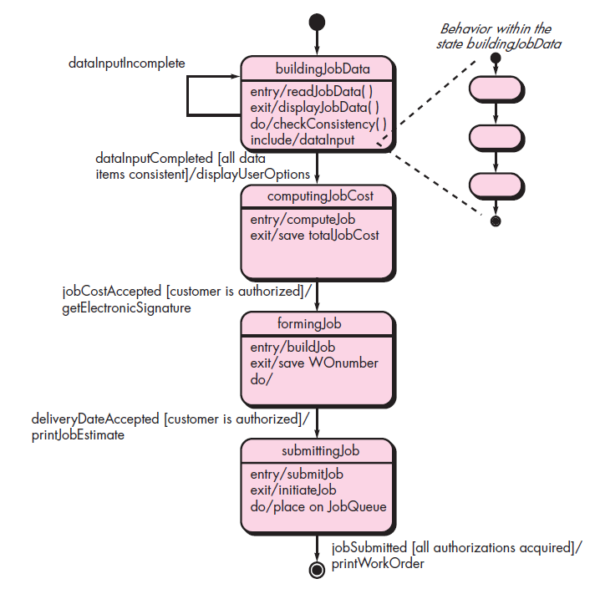
Step 5 – Elaborate Behavior
It is sometimes necessary to model the behavior of a design class.
Transitions from state to state have the form:
  Event-name (parameter-list) [guard-condition] / action expression

Slide 41
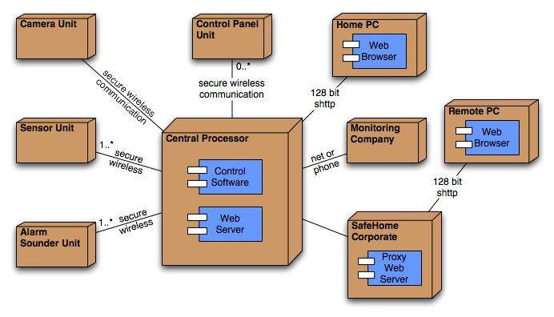
Step 6 – Elab. Deployment
Deployment diagrams are elaborated to represent the location of key packages or components.

Slide 42
Designing Conventional Components

Slide 43
Introduction
Conventional design constructs emphasize the maintainability of a functional/procedural program
  Sequence, condition, and repetition
Each construct has a predictable logical structure where control enters at the top and exits at the bottom, enabling a maintainer to easily follow the procedural flow
Various notations depict the use of these constructs
  Graphical design notation
    Sequence, if-then-else, selection, repetition (see next slide)
  Tabular design notation (see upcoming slide)
  Program design language
    Similar to a programming language; however, it uses narrative text embedded directly within the program statements

Slide 44
Graphical Design Notation
T
F
Sequence
If-then-else
T
F
F
T
F
T
T
F
Selection
Repetition

Slide 45
Graphical Example used for Algorithm Analysis
1 int functionZ(int y)
2 {
3 int x = 0;
4 while (x <= (y * y))
5 {
6 if ((x % 11 == 0) &&
7 (x % y == 0))
8 {
9 printf(“%d”, x);
10 x++;
11 } // End if
12 else if ((x % 7 == 0) ||
13 (x % y == 1))
14 {
15 printf(“%d”, y);
16 x = x + 2;
} // End else
18 printf(“\n”);
19 } // End while
20 printf("End of list\n");
21 return 0;
22 } // End functionZ
3
4
6
7
9
12
13
10
15
16
18
20
21

Slide 46
Tabular Design Notation
List all actions that can be associated with a specific procedure (or module)
List all conditions (or decisions made) during execution of the procedure
Associate specific sets of conditions with specific actions, eliminating impossible combinations of conditions; alternatively, develop every possible permutation of conditions
Define rules by indicating what action(s) occurs for a set of conditions
(More on next slide)

Slide 47
Tabular Design Notation (continued)
Rules
Conditions | 1 | 2 | 3 | 4 | 5 | 6
Regular customer | T | T
Silver customer |  |  | T | T
Gold customer |  |  |  |  | T | T
Special discount | F | T | F | T | F | T
Actions
No discount | 
8% discount |  |  |  | 
15% discount |  |  |  |  |  | 
Additional x% discount |  |  |  |  |  | 

Slide 48
Program design language
easy to combine with source code
machine readable, no need for graphics input
graphics can be generated from PDL
enables declaration of data as well as procedure
easier to maintain
F
if condition x
then process a;
else process b;
Endif
T
If-then-else

Slide 49
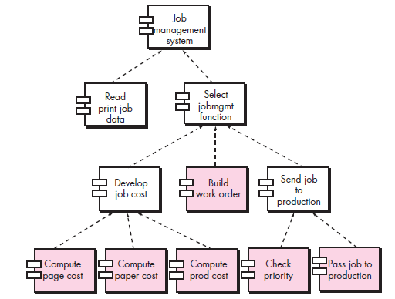
Traditional view

Slide 50
Component-Based Development
When faced with the possibility of reuse, the software team asks:
  Are commercial off-the-shelf (COTS) components available to implement the requirement?
  Are internally-developed reusable components available to implement the requirement?
  Are the interfaces for available components compatible within the architecture of the system to be built?
At the same time, they are faced with the following impediments to reuse ...

Slide 51
Impediments to Reuse
Few companies and organizations have anything that even slightly resembles a comprehensive software reusability plan.
Although an increasing number of software vendors currently sell tools or components that provide direct assistance for software reuse, the majority of software developers do not use them.
Relatively little training is available to help software engineers and managers understand and apply reuse.
Many software practitioners continue to believe that reuse is “more trouble than it’s worth.”
Many companies continue to encourage of software development methodologies which do not facilitate reuse
Few companies provide an incentives to produce reusable program components.

Slide 52
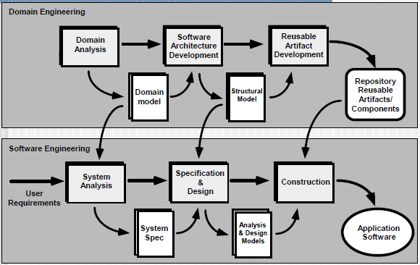
The CBSE Process

Slide 53
Domain Engineering
Define the domain to be investigated.
Categorize the items extracted from the domain.
Collect a representative sample of applications in the domain.
Analyze each application in the sample.
Develop an analysis model for the objects.

Slide 54
Identifying Reusable Components
Is component functionality required on future implementations?
How common is the component's function within the domain?
Is there duplication of the component's function within the domain?
Is the component hardware-dependent?
Does the hardware remain unchanged between implementations?
Can the hardware specifics be removed to another component?
Is the design optimized enough for the next implementation?
Can we parameterize a non-reusable component so that it becomes reusable?
Is the component reusable in many implementations with only minor changes?
Is reuse through modification feasible?
Can a non-reusable component be decomposed to yield reusable components?
How valid is component decomposition for reuse?

Slide 55
Component-Based SE
a library of components must be available
components should have a consistent structure
a standard should exist, e.g.,
  OMG/CORBA
  Microsoft COM
  Sun JavaBeans

Slide 56
CBSE Activities
A sequence of component based development actions is applied when a component is proposed for reuse
  Component qualification
  Component adaptation
  Component composition
  Component update

Slide 57
Qualification
Before a component can be used, you must consider:
  application programming interface (API)
  development and integration tools required by the component
  run-time requirements including resource usage (e.g., memory or storage), timing or speed, and network protocol
  service requirements including operating system interfaces and support from other components
  security features including access controls and authentication protocol
  embedded design assumptions including the use of specific numerical or non-numerical algorithms
  exception handling

Slide 58
Adaptation
The implication of “easy integration” is:
  that consistent methods of resource management have been implemented for all components in the library;
  that common activities such as data management exist for all components, and
  that interfaces within the architecture and with the external environment have been implemented in a consistent manner.

Slide 59
Composition
An infrastructure must be established to bind components together
Architectural ingredients for composition include:
  Data exchange model
  Automation
  Structured storage
  Underlying object model

Slide 60
OMG/ CORBA
The Object Management Group has published a common object request broker architecture (OMG/CORBA).
An object request broker (ORB) provides services that enable reusable components (objects) to communicate with other components, regardless of their location within a system.
Integration of CORBA components (without modification) within a system is assured if an interface definition language (IDL) interface is created for every component.
Objects within the client application request one or more services from the ORB server. Requests are made via an IDL or dynamically at run time.
An interface repository contains all necessary information about the service’s request and response formats.

Slide 61
Microsoft COM
The component object model (COM) provides a specification for using components produced by various vendors within a single application running under the Windows operating system.
COM encompasses two elements:
  COM interfaces (implemented as COM objects)
  a set of mechanisms for registering and passing messages between COM interfaces.

Slide 62
Sun JavaBeans
The JavaBeans component system is a portable, platform independent CBSE infrastructure developed using the Java programming language.
The JavaBeans component system encompasses a set of tools, called the Bean Development Kit (BDK), that allows developers to
  analyze how existing Beans (components) work
  customize their behaviour and appearance
  establish mechanisms for coordination and communication
  develop custom Beans for use in a specific application
  test and evaluate Bean behaviour.

Slide 63
Classification
Enumerated classification—components are described by defining a hierarchical structure in which classes and varying levels of subclasses of software components are defined
Faceted classification—a domain area is analyzed and a set of basic descriptive features are identified
Attribute-value classification—a set of attributes are defined for all components in a domain area

Slide 64
The Reuse Environment
A component database capable of storing software components and the classification information necessary to retrieve them.
A library management system that provides access to the database.
A software component retrieval system (e.g., an object request broker) that enables a client application to retrieve components and services from the library server.
CBSE tools that support the integration of reused components into a new design or implementation.

Slide 65
End

